Slide 1
Anti-bullying action in the Presentation Secondary School Thurles
By our PR and Wellbeing Teams

Slide 2
About our Team!!
This year our TY Wellbeing and Public Relations team decided to act against bullying. We held an Anti-bullying week from Monday15th to Friday19th.
Over the course of two weeks, we planned and came up with ways to make people aware of bullying, how to deal with it and how to help.
With the help of our teachers, we were able to spread our positive message throughout our whole school.

Slide 3
Our Anti-Bullying week!
The week consisted of kahoots for our junior years educating them on the right way to handle bullies and bullying in the school.
We also hung posters made by members of the school that reflected all aspects of when and where bullying can occur and how to deal with it.
We drew and painted LGBTQIA+ pride flags and hung to them up to represent inclusivity and equality in our school environment.

Slide 4
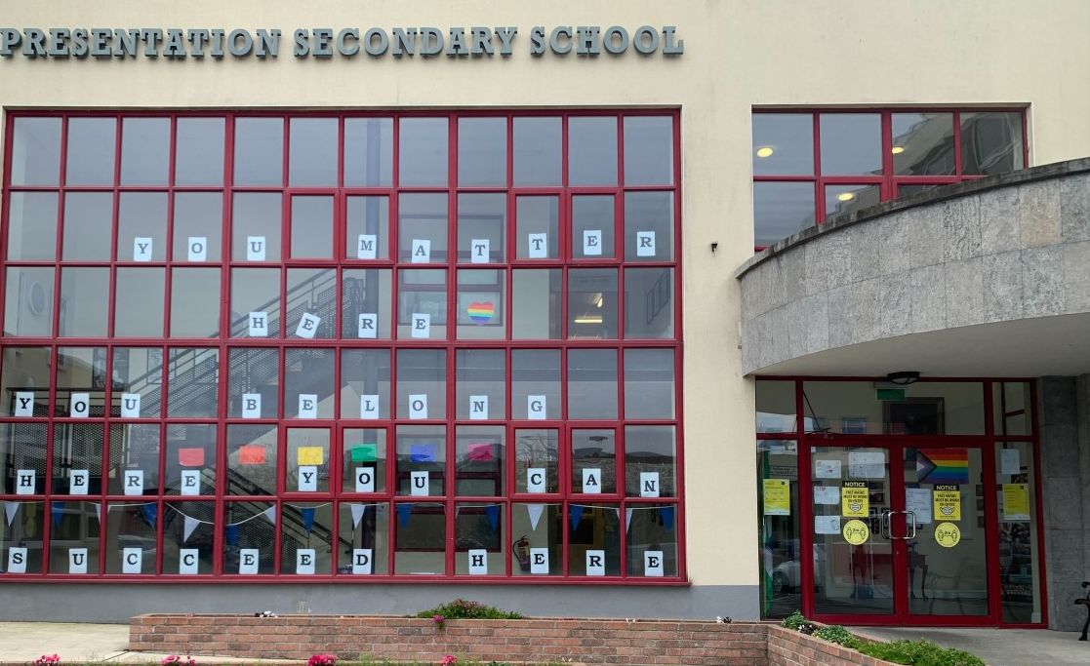
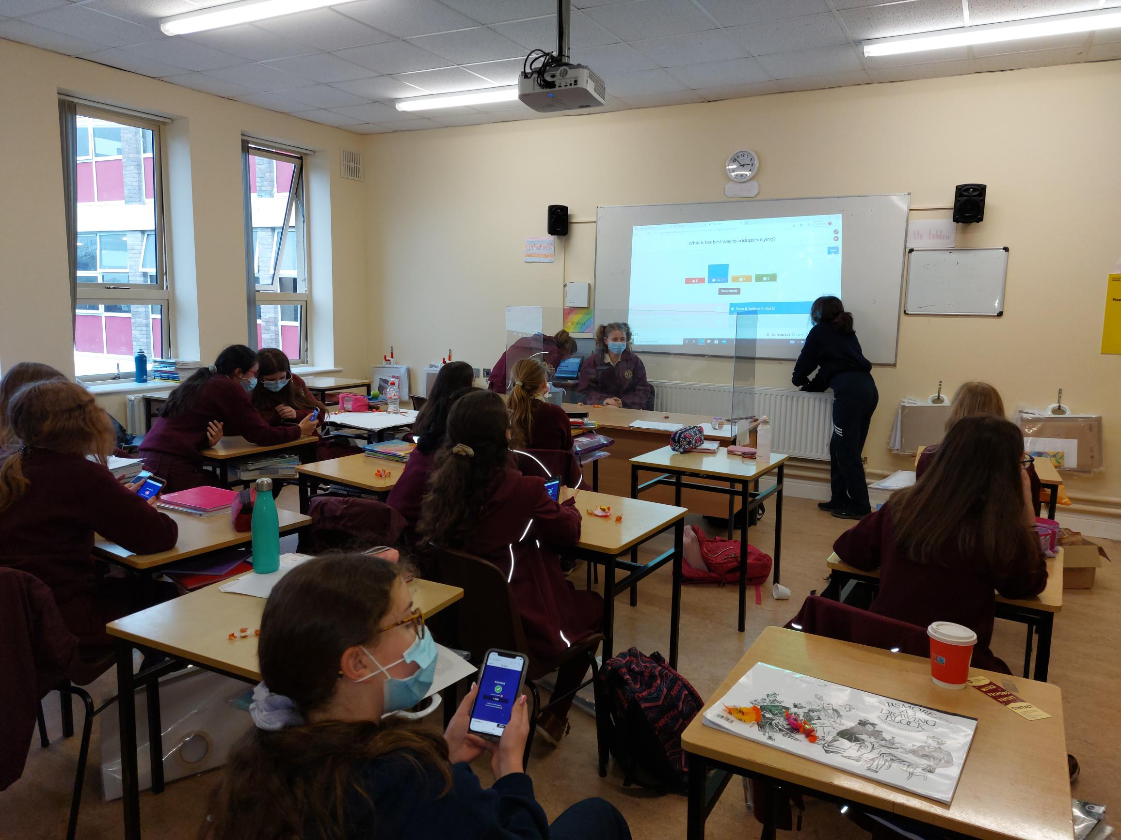
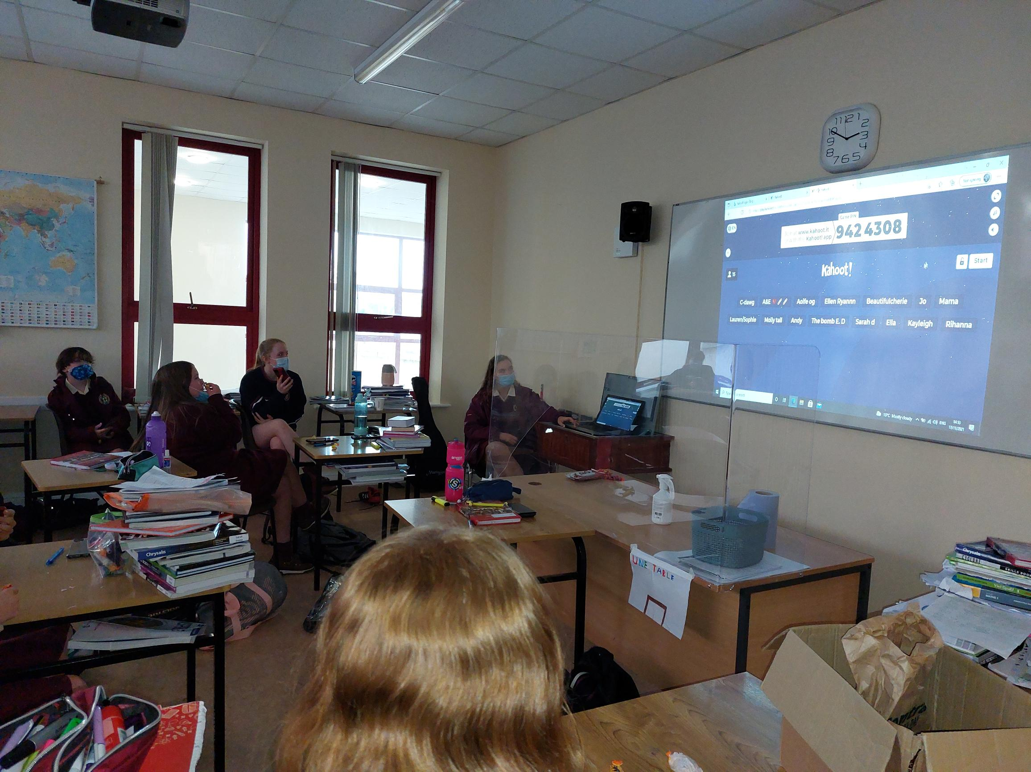
Pride flags
Anti-bullying Kahoot

Slide 5
Our Anti-Bullying week!
We also handed out bookmarks to the whole school with the quote "notice, respond, report"
Our wellbeing team taught the first years an inclusivity dance to represent togetherness through being active.
On Friday, to celebrate coming together through our individuality, we hosted an odd sock competition with a prize for the best odd socks in each year.

Slide 6
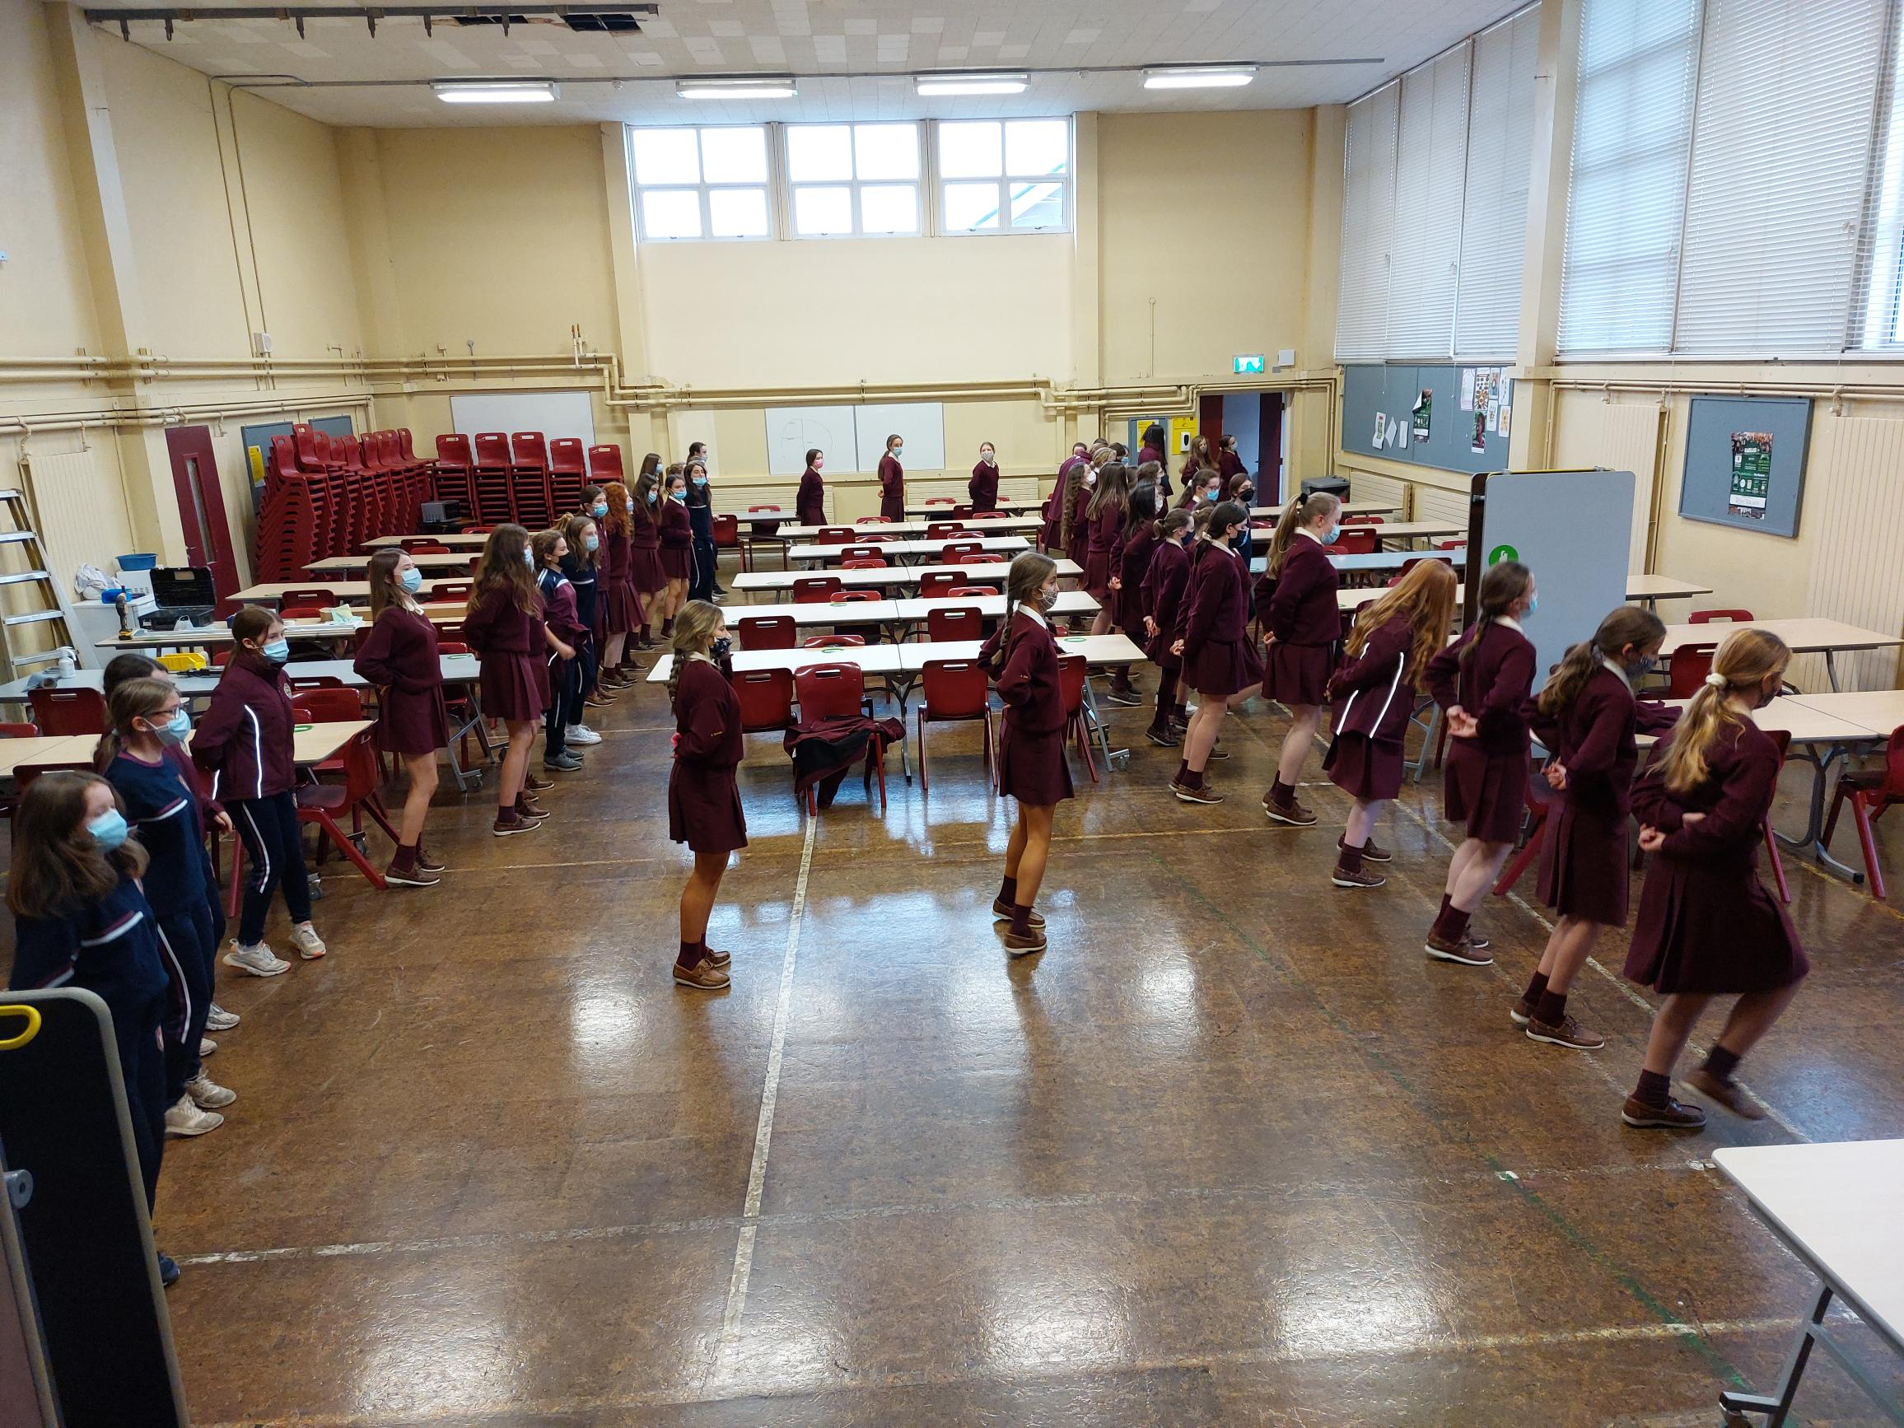
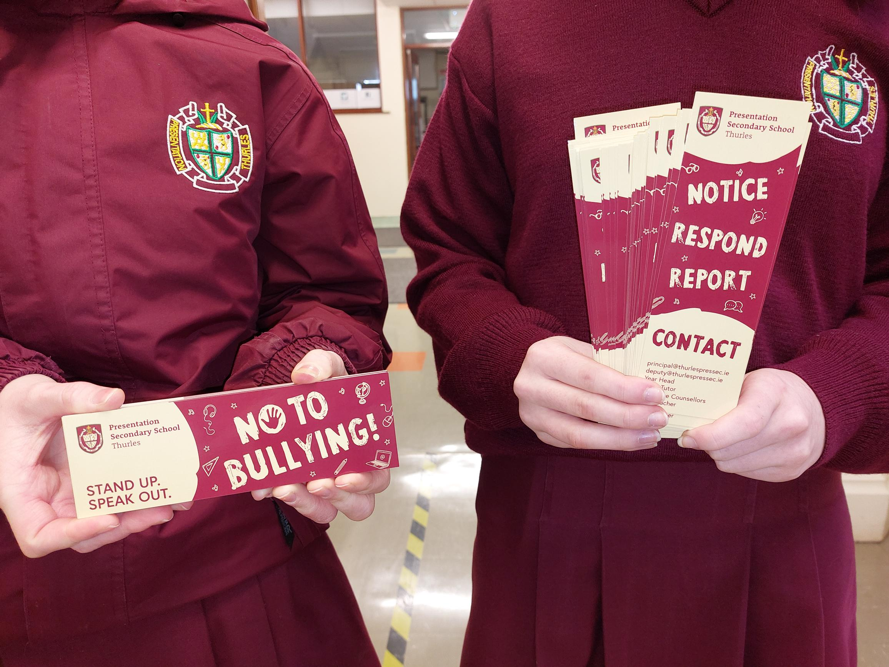
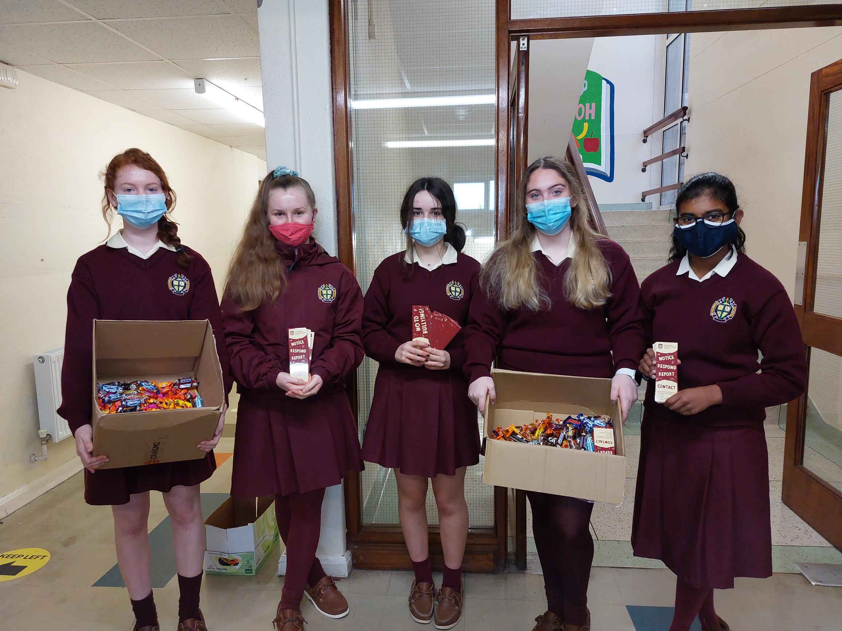
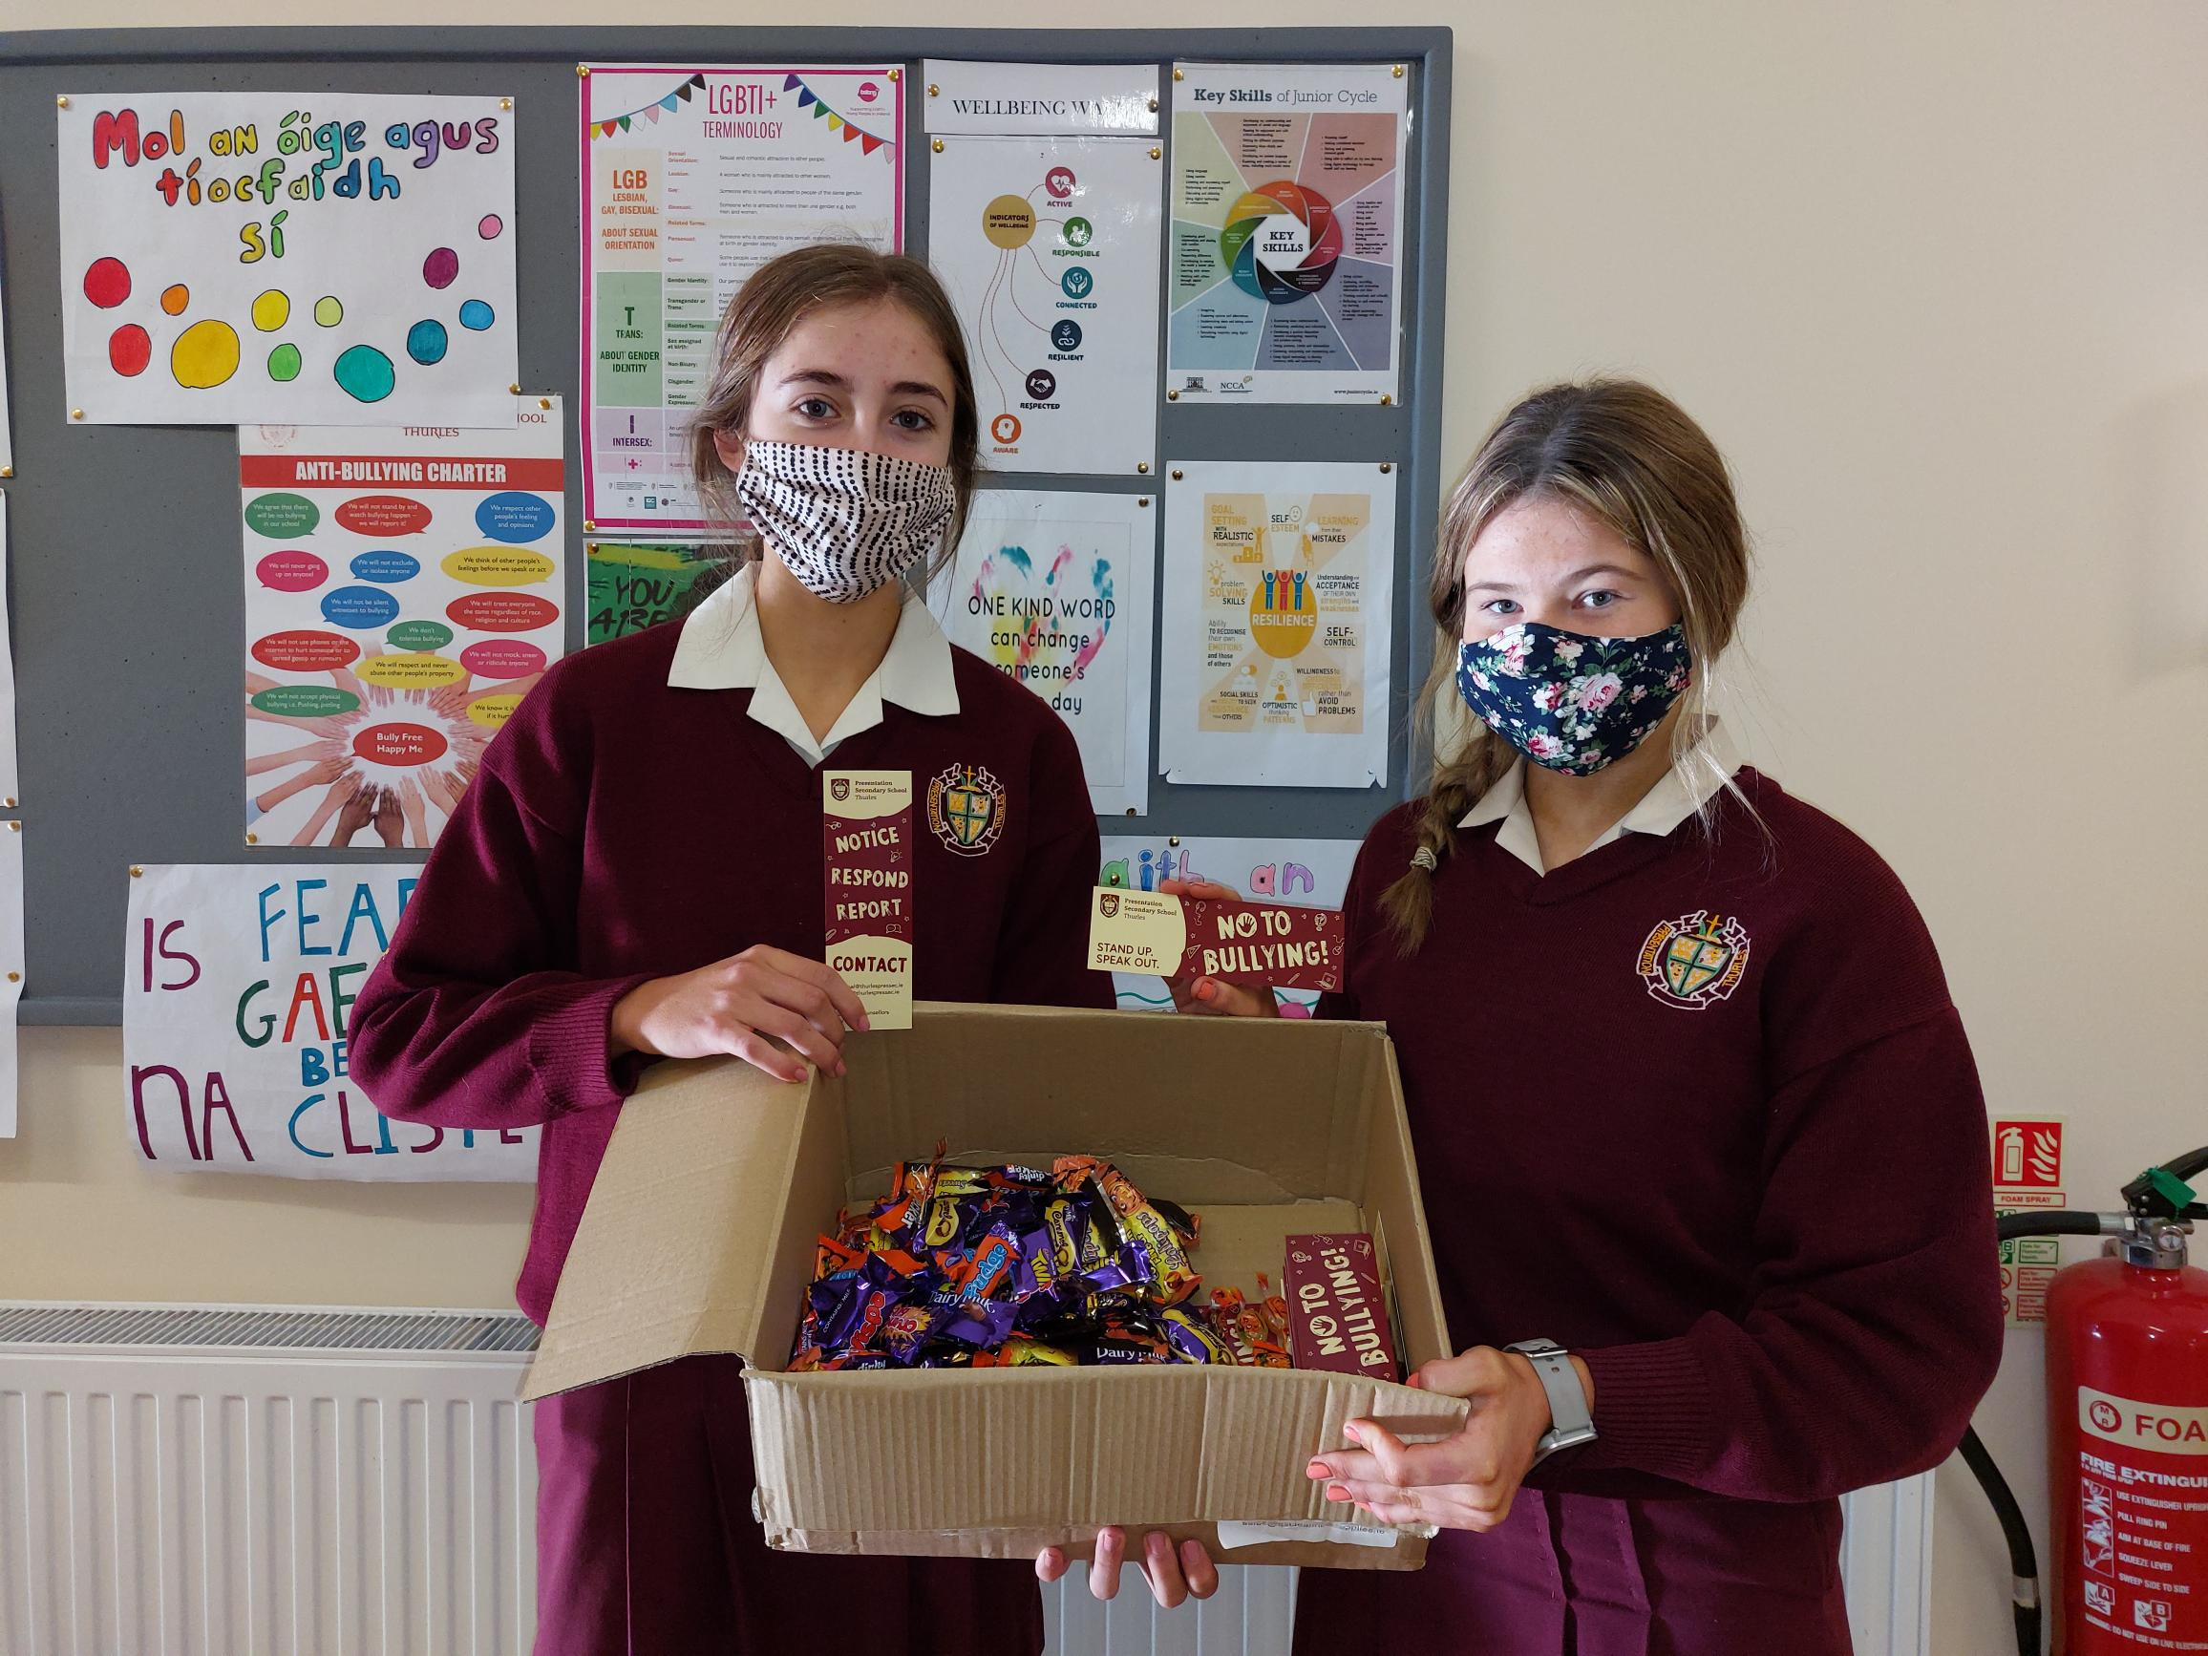
Dancing, bookmarks and odd sock day

Slide 7
Our First year inclusivity dance!!!
Click here to see!!

Slide 8
Our Anti bullying week!
First years designed posters for our wellbeing wall, and we displayed some more anti-bullying posters around the school.
The wellbeing committee announced a wellbeing quote at the start of the week, and it was displayed around the school and on notice boards. It also featured on our anti-bullying wall, along with educational posters on what to do when you experience or witness bullying.
In order to spread awareness for inclusivity week, we placed posters containing LGBTQIA+ terminology to educate the students on these important topics.

Slide 9
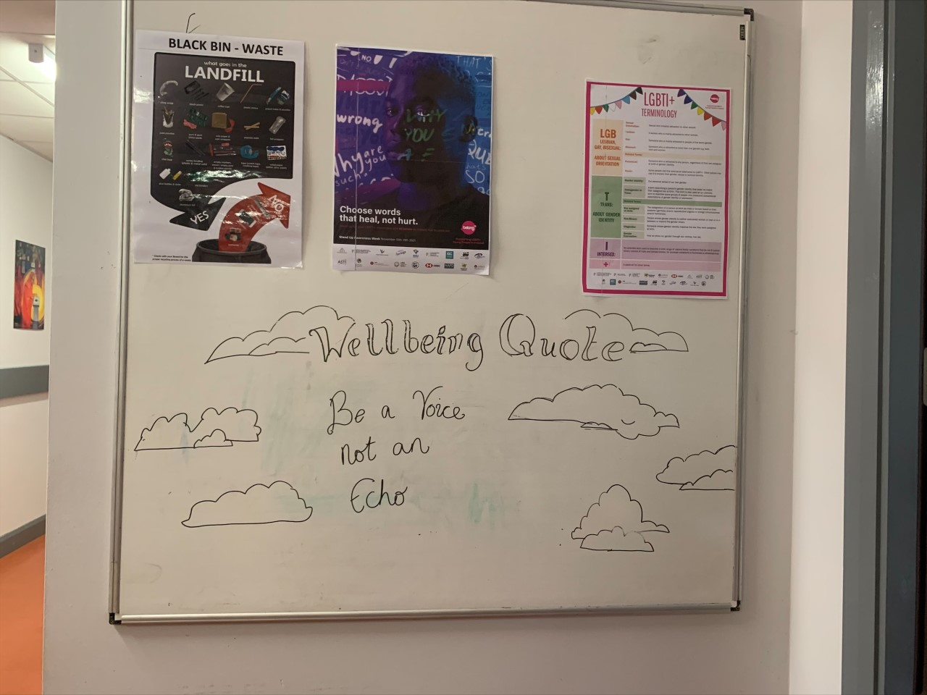
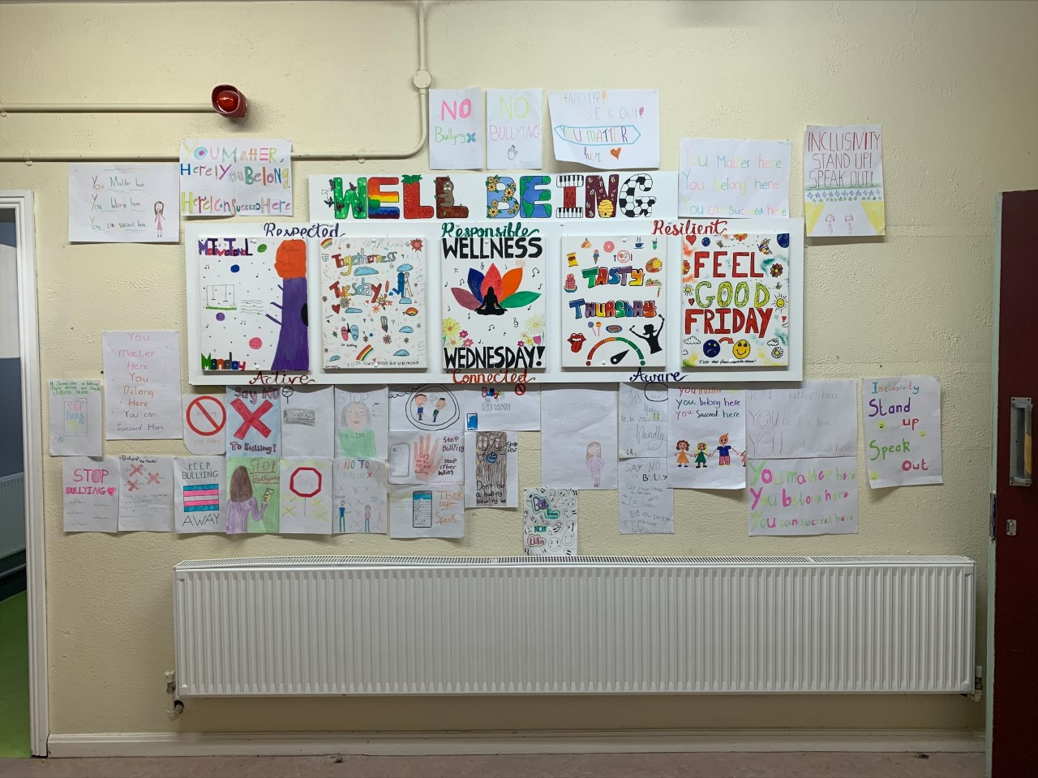
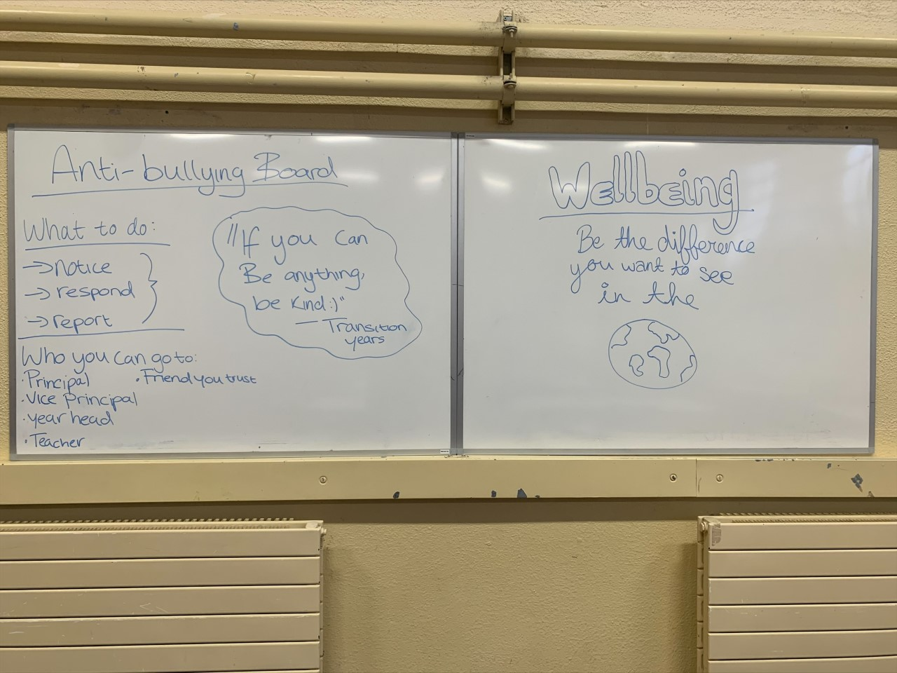
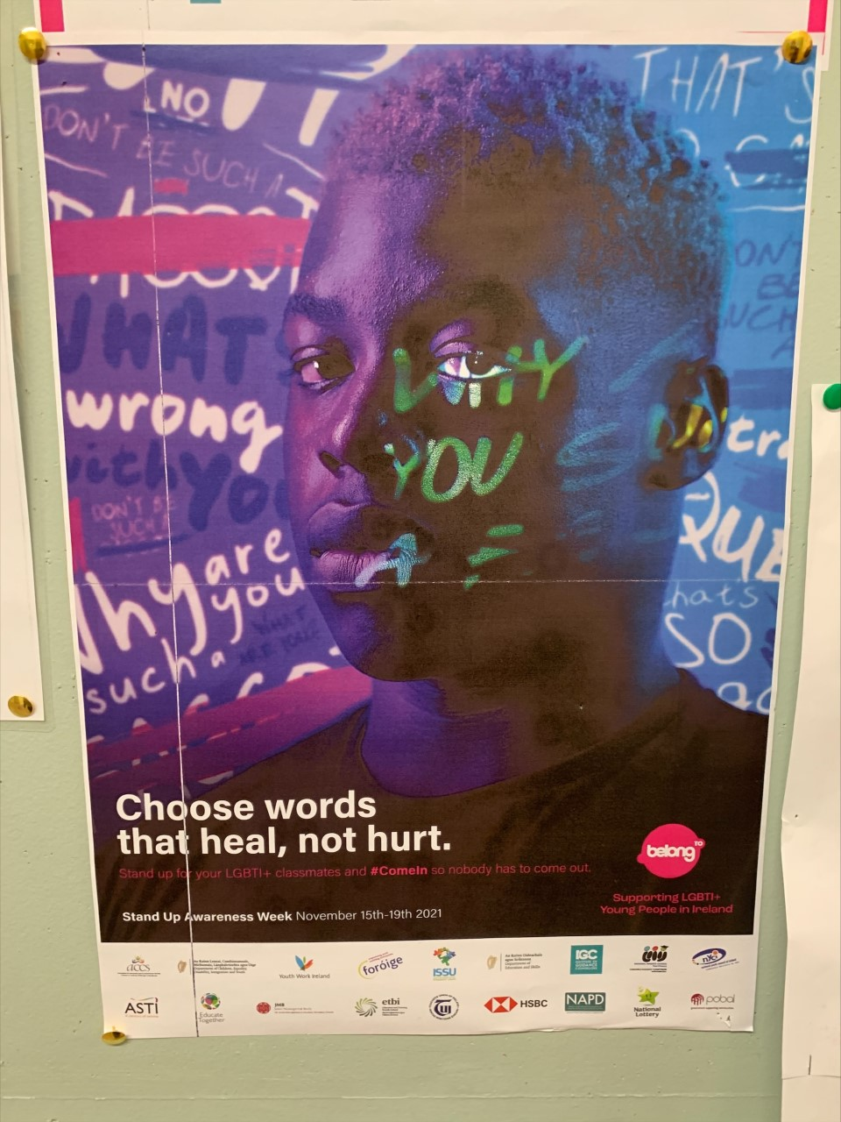
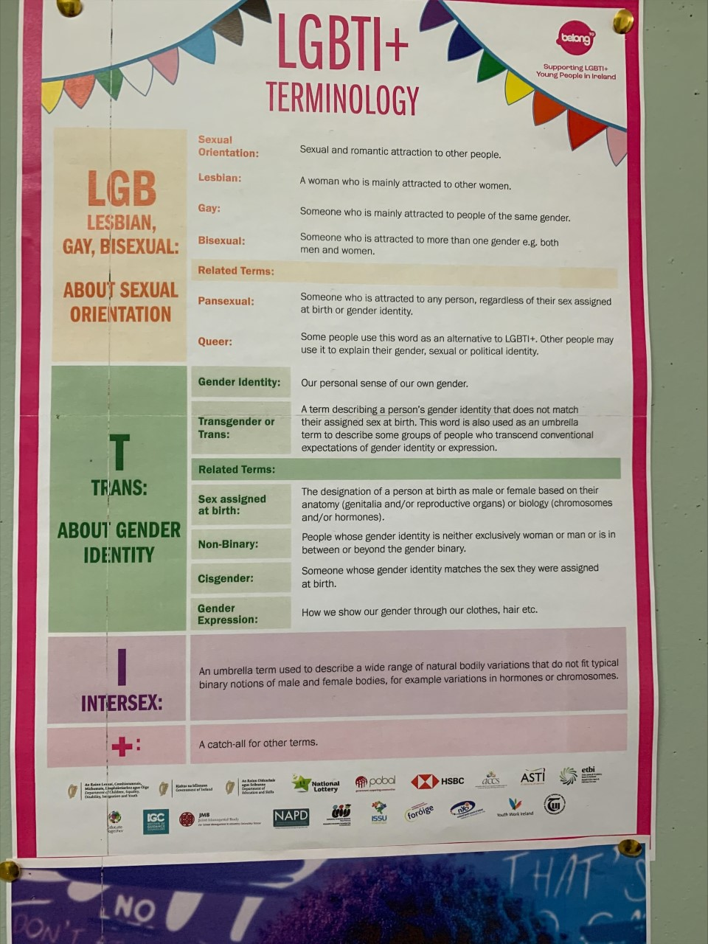
Our wellbeing walls
Posters around the school

Slide 10
Our anti – bullying week
Our student council updated our school anti-bullying charter to be more inclusive. It has been updated to include more relevant issues, such as cyber-bullying and LGBTQIA+ bullying.
We made the students aware that there are many different kinds of bullying and mentioned the different kinds in our updated anti-bullying charter.

Slide 11
Preparation for anti-bullying week and after
Our well-being co-ordinator surveyed students from each year group pre and post anti-bullying week. We plan to take on board any comments or suggestions students have to stop bullying in our school. Student voices are listened to in our school community.

Slide 12
Thank you for reading / watching our PowerPoint presentation. We hope you enjoyed #antibullyinginacampaign

