Slide 1
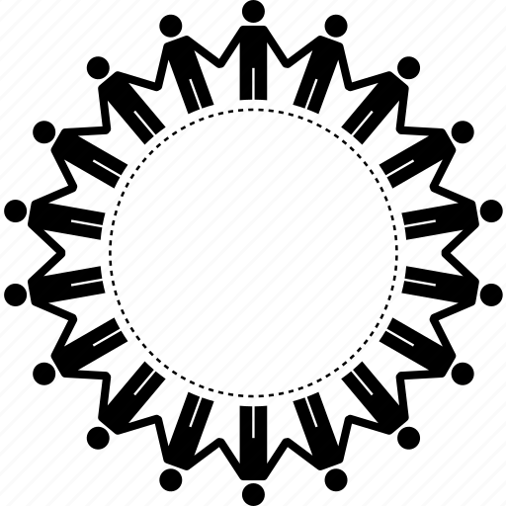
Anti-bullying
By: Aamna Iqbal

Slide 2
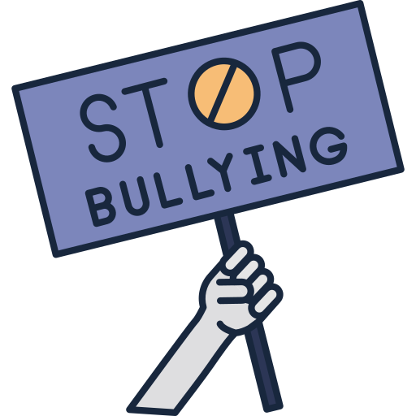
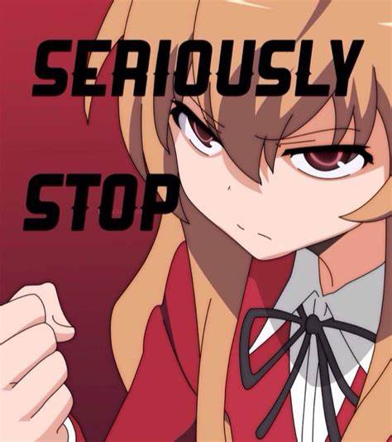
What is Anti-bullying?
Anti-bullying is a movement to reduce or eliminate bullying. It was created to stop bullying and create a safer place for people to be themselves. It was made to make people understand that everyone is different, and that’s okay. It was created to stop violence against other people for not fitting into societies expectations. It was made to teach people to love instead of hate.

Slide 3
How can I stop bullying?!?
Educate the people around you and stand up to bullying if you see it.
Stopping bullying is a collective job. Bullying is made from a lack of understanding and ignorance. Someone might be told from a young age that something is weird and wrong, so later in life they begin to believe what they were told, and inflict pain on others. no one is born a bully. To stop bullying we need the cooperation of the bullys, we need their cooperation and patience for them to be willing to learn and see their wrong doing, and then act on it. We need them to know that what their doing is wrong.

Slide 4
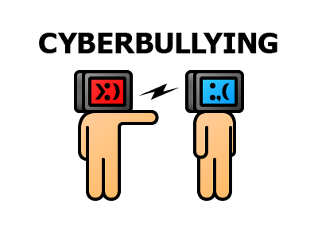
Cyber-bullying
Cyber-bullying has grown allot thanks to social media and the ability to become someone else. People will sometime make themselves anonymous, just so they can bully people without getting the backlash of others defending them. cyber-bullies are the biggest cowards. Don’t believe me? Next time if someone says something mean about you online and you know them irl, confront them. show them the mean message or tweet and tell them face to face why they did that. In fact, do it in public. You’ll see how quickly they deny it and run with their tails in between their legs. Don’t be afraid of Cyber-bullies, there just big cowards who are afraid to go face to face with you. Cyber-bullies usually just have to much time on their hands and cant think of a better way to use it.

Slide 5
what can I do if a friend is being bullied???
The best thing you can do is make sure they don’t feel alone. Or are alone because they can get jumped. You should tell an adult and stay with them the whole time. Being bullied with a friend is better than being alone, because at least you will have eachothers back and will be able to laugh about it in the future. You should confront their bullies and stick together! tell your parents, teachers and principal in fact tell the bullies parents! I’m sure they’ll get the scolding of a lifetime. Another thing you can do is talk to them and make sure they are okay. Many people kill themselves thanks to bullying.

Slide 6
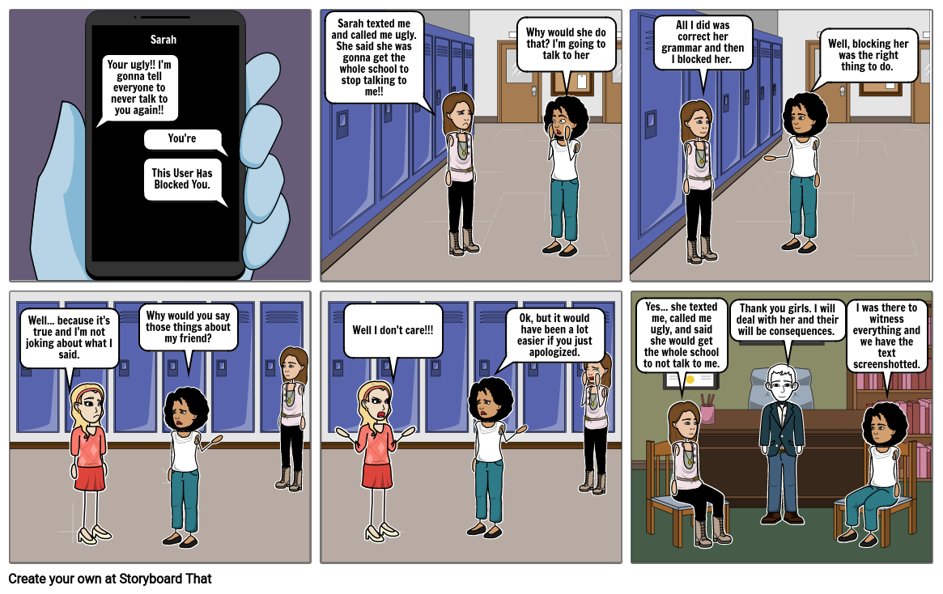
Here is a small comic I found to help you

Slide 7
If someone tell you their being bullied. Don’t brush it off.
One of the children here is a bully and another is the victim. Can you tell me who is the bully and who is the victim.
Nope, neither can I!
Bullies come in all shapes and sizes. Some are tall, some are short, some are rich some are poor. You cant see if someone is a bully or victim by their appearance. That’s why is someone confesses to be being bullied, don’t brush them off or say “how can you be bullied your so…” instead try to help them, and if someone says she or he is a bully because of their appearance or background, don’t belive them until you have proof. Remember everyone is innocent until proven guilty.

Slide 8
Don’t judge what others love
There will be a thousand things you don’t like or think is weird, and that’s fine, there are plenty of things you will like that others wont like or will think is weird. Its what we do with these feelings that matter. I don’t like the colour brown but I wont bash on the people who do like it. Instead I can share my opinion, but I shouldn’t hurt or bully the people who do like it. Sometimes, we can practise not saying something if it will result in hurting someone else. In conclusion we should think before we speak and be mindful of others.

Slide 9
Thank you
Thank you for reading my power point project. I had a lot of fun with it and I sincerely hope this will help at least one person going forward. I think that if we all just treated others how we want to be treated the world would be a better place, and that can be applied to not only bullying but everything in general.

