Slide 1
Ardgillan College Positivity Day
Thursday, 4th of November 2021

Slide 2
Five Key Kindness Questions
1) Am I kind to myself?
2) Am I kind to others?
3) Are people kind to me?
4)Do I understand when people are kind to me?
5) Do I help people who are being bullied?

Slide 3
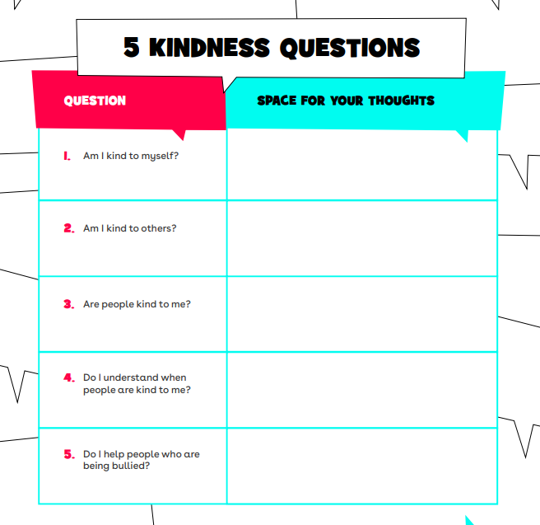

Slide 4
Let's Discuss
"Our school is a kind place"

Slide 5
Take down the following question, use the video you are going to watch to help you answer it:
"How can one kind word/act/deed have a positive impact?"

Slide 6
You find out that a group of your friends have been anonymously posting unkind and threatening comments about a student in your school TikTok videos. You know that they are sad and scared about it but they are not in your friendship group so you don’t know how to approach them.
What could you do to spread kindness and stop bullying?

Slide 12
Can you think of 50 positive/kind things you can do in any given day?

