Slide 1
Bullying
and how to stop it
By Alan, Artur and Jamie

Slide 2
What Is Bullying?
Bullying is an intentional recurring negative behaviour against a person who can’t defend themselves.
Types of bullying include:
Verbal (Name-calling, insults or humiliation.)
Physical (Pushing, shoving, kicking, etc., including damage to property.)
Gesture (Threatening gestures such as a throat-slitting gesture.)
Exclusion (Excluding or ignoring someone.)
Extortion (Forcing another person to give away their property or money.)

Slide 3
How Can I Tell If Someone Is Being Bullied?
Bullying can sometimes go unnoticed if you have not been made aware of it.
Many students do not tell someone that they are being bullied. This is an issue.
In fact, around 65% of people who are bullied don’t tell an adult about it.
This means that we need to learn to spot the signs of bullying.
65%

Slide 4
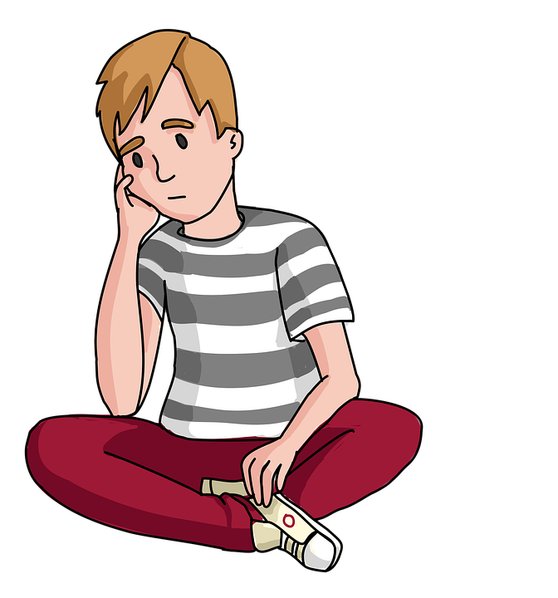
How Can I Tell If Someone Is Being Bullied?
Some signs that a person is being bullied include:
Victims may not want to say what is wrong.
Unexplained bruising and cuts.
Damage to property.
Excuses for not wanting to attend school.
Lowered confidence/self-esteem.
Difficulty sleeping.
Some of these signs can be noticed in a child’s behaviour as a result of any type of bullying.

Slide 5
How Can I Report Bullying?
You can report bullying in a ton of ways, but the most effective way is to seek help from an adult you trust.
This could be a teacher, school staff, parents or an older sibling. The most important part is to ask for help, because when you report bullying, you not only help the person being targeted, but also the person who is bullying.

Slide 6
Witnesses
A witness is anyone who sees bullying when it happens.
Witnesses often don’t try to help because:
They may be concerned for their own safety.
Don’t know what they should do to help.
Afraid that they may be picked on.
Might be friends with the person/people who are bullying.

Slide 7
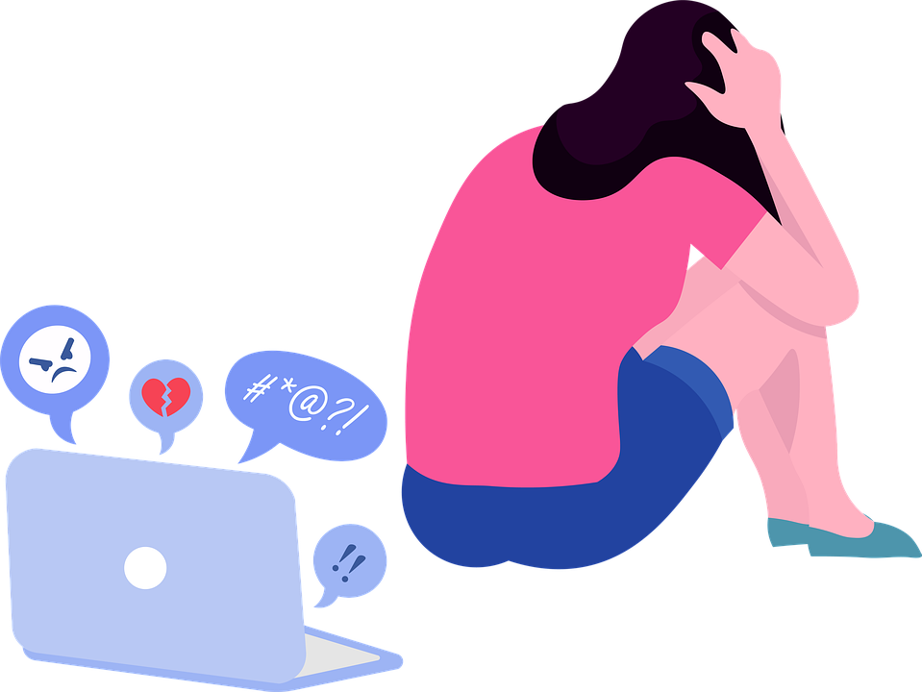
About Cyberbullying
Cyberbullying is an intentional recurring negative behaviour against a person who can’t defend themselves using electronic devices and the Internet.
Cyberbullying can be considered as different to bullying. Cyberbullying can become a 24/7 offense, and the bully can hide their identities using anonymity to attack known victims. Some of the ways that people can be cyberbullied are:
Exclusion (Telling someone that they aren’t invited to a party, etc.)
Doxxing (Revealing personal information to the public.)
Harassment (Sending hurtful, severe and persistent messages to someone.)
Phishing (Stealing the victim’s financial information.)
Impersonation (Impersonating the victim to make them look bad.)

Slide 8
How To Stop Cyberbullying
Stopping cyberbullying might seem like an overwhelming task at first. It is always recommended to inform an adult you trust if you are being cyberbullied or suspect that somebody you know is being cyberbullied.
Report harmful messages to the social network or content moderators.
Block people who bully online and encourage victims to do the same.
Look for help from an adult or teacher.
Here’s some tips to be safe on the Internet.
Do not accept friend requests from people you do not know.
Do not give your home address, mobile number, email address, the school you go to to the public.
Don’t say anything on the internet if you wouldn’t say it in a crowded room.
If you are using social networking sites, remember to never give out personal information or photos; instead use a nickname.
Do not open files from people you don’t know.

Slide 9
The End
By: Alan, Artur and Jamie
6th Class
Scoil Bhride Shantalla

